Slide 1
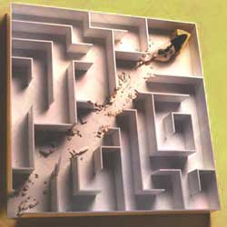
Reinforcement Learning
Module 6CM521: Frontiers in AI and Data Science
Ioannis Tsioulis (MC)
Slides acknowledgements:
Dr Hong Qing Yu

Slide 2
Acknowledgement
Most of the slides are adapted from the lecture slides of Dr Hong Qing Yu (Harry).
Slides 3–7 and 28 are based on Max Welling's reinforcement learning lecture slides; slides 8–26 are based on deeplizard's course “Reinforcement Learning – Goal Oriented Intelligence” (deeplizard.com).

Slide 3
Overview
Supervised Learning: Immediate feedback (labels provided for every input).
Unsupervised Learning: No feedback (no labels provided).
Reinforcement Learning (RL): Delayed scalar feedback (a number called reward).
RL deals with agents that must sense & act upon their environment.
This combines classical AI and machine learning techniques.
It is the most comprehensive problem setting.
Examples:
  A robot cleaning my room and recharging its battery
  Robot-soccer
  How to invest in shares
  Modeling the economy through rational agents
  Learning how to fly a helicopter
  Scheduling planes to their destinations
  and so on
Notes:
<number>

Slide 4
Complications
The outcome of your actions may be uncertain
You may not be able to perfectly sense the state of the world
The reward may be stochastic.
Reward is delayed (e.g. finding food in a maze)
You may have no clue (model) about how the world responds to your actions.
You may have no clue (model) of how rewards are being paid off.
The world may change while you try to learn it
How much time do you need to explore uncharted territory before you exploit what you have learned?
Notes:
<number>

Slide 5
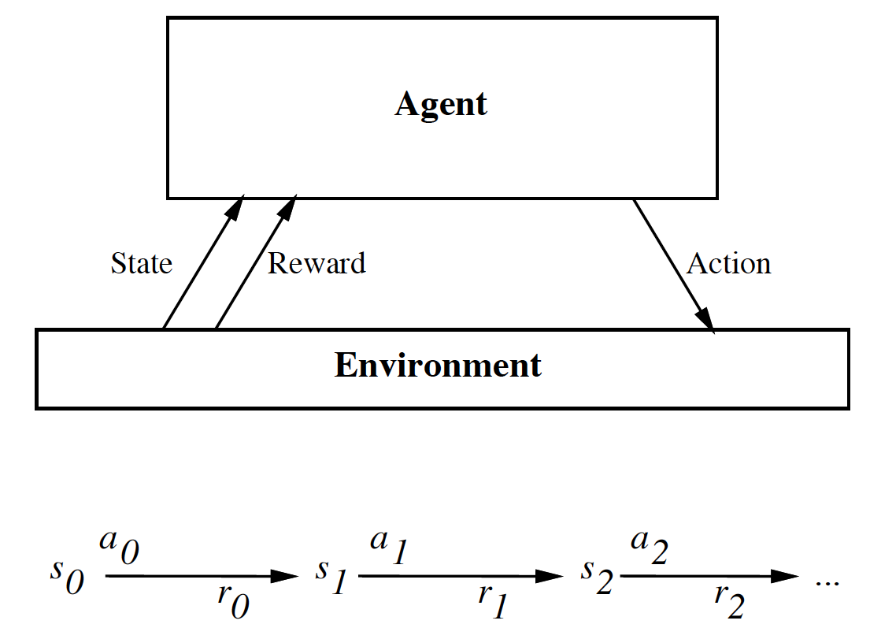
The Big Picture
Guiding process
e.g. Q-table
Policy
Learning process
Your action influences the state of the world which determines its reward
Notes:
<number>

Slide 6
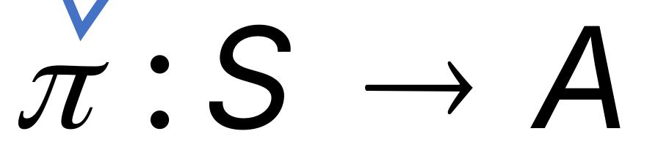
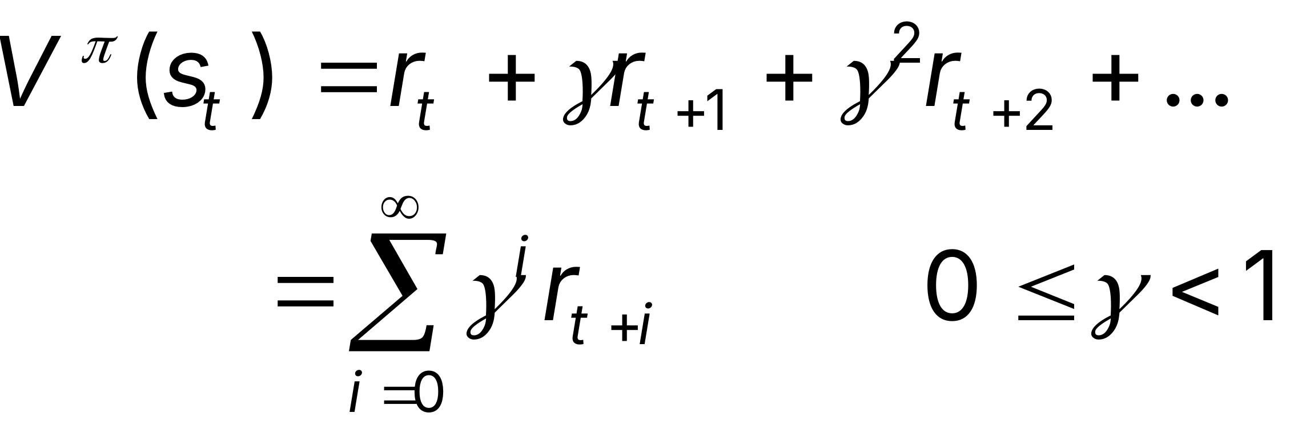
The Task
To learn an optimal policy that maps states of the world to actions of the agent.
E.g., if this patch of room is dirty, I clean it. If my battery is empty, I recharge it.
What is it that the agent tries to optimize?
Answer: the total future discounted reward:
Note: immediate reward is worth more than future reward.
Notes:
<number>

Slide 7
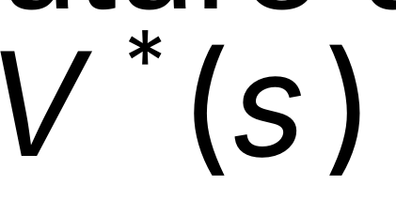
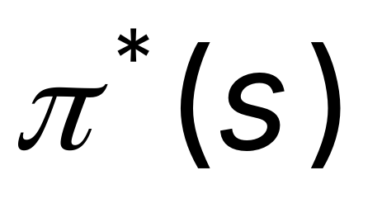
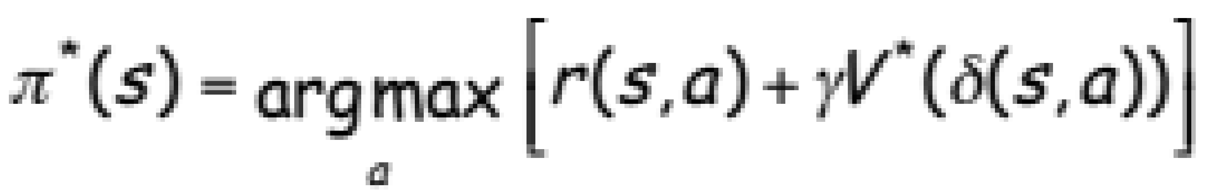
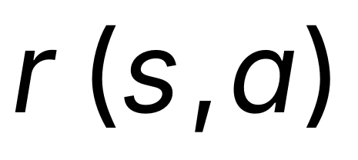
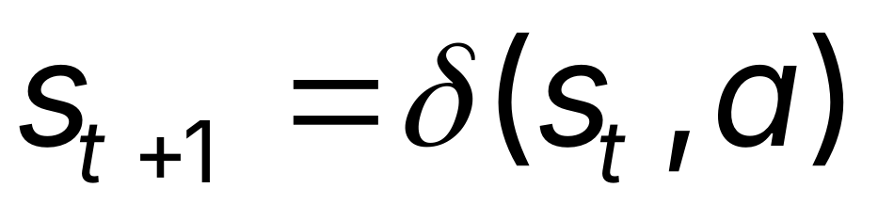
Value Function
Let’s say we have access to the optimal value function that computes the total future discounted reward.
What would be the optimal policy ?
Answer: we choose the action that maximizes:
We assume that we know what the reward will be if we perform action “a” in state “s”:
We also assume we know what the next state of the world will be if we perform action “a” in state “s”:
Notes:
<number>

Slide 8
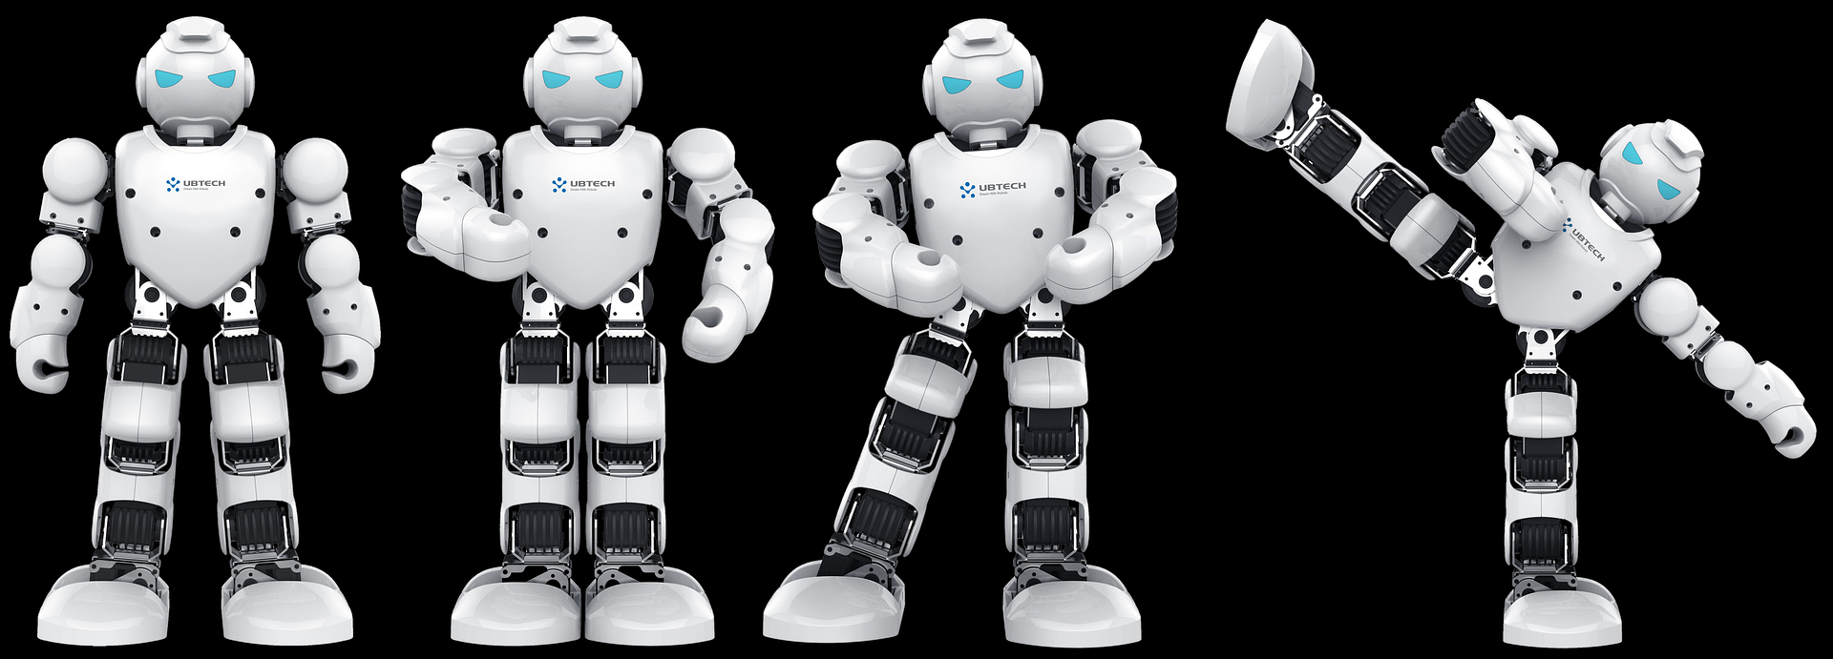
How do we structure a Reinforcement Learning problem formally?
MDP: Markov Decision Process (MDP) - Structuring A Reinforcement Learning Problem
MDP gives us a way to formalize sequential decision making. This formalization is the basis for structuring problems that are solved with reinforcement learning.

Slide 9
Components Of An MDP
In an MDP, we have a decision maker, called an agent, that interacts with the environment it's placed in. These interactions occur sequentially over time. At each time step, the agent will get some representation of the environment’s state. Given this representation, the agent selects an action to take. The environment is then transitioned into a new state, and the agent is given a reward as a consequence of the previous action.
Components of an MDP over time:
  Agent
  Environment
  State
  Action
  Reward
Notes:
This process of selecting an action from a given state, transitioning to a new state, and receiving a reward happens sequentially over and over again, which creates something called a trajectory that shows the sequence of states, actions, and rewards.
Throughout this process, it is the agent’s goal to maximize the total amount of rewards that it receives from taking actions in given states. This means that the agent wants to maximize not just the immediate reward, but the cumulative rewards it receives over time.
<number>

Slide 10
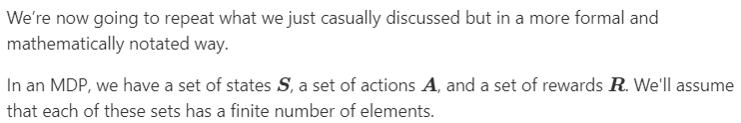
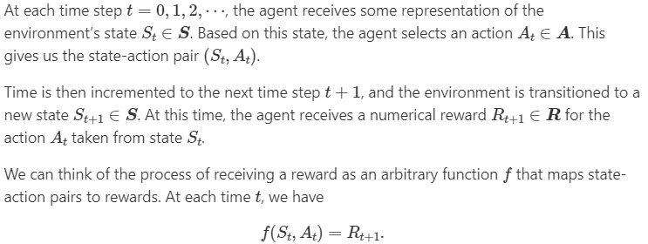

MDP Notation

Slide 11
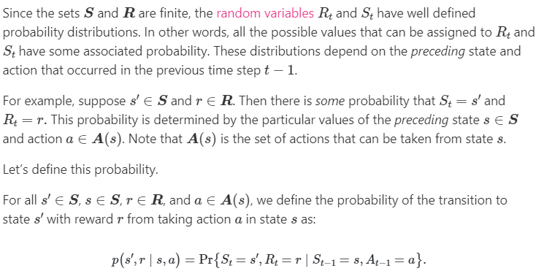
Transition Probabilities

Slide 12

Expected Return - What Drives A Reinforcement Learning Agent In An MDP
As we stated, the goal of an agent in an MDP is to maximize its cumulative rewards, so we need a way to aggregate and formalize these cumulative rewards. For this, we introduce the concept of the expected return of the rewards at a given time step.
For now, we can think of the return simply as the sum of future rewards. Mathematically, we define the return G at time t as
Think about: Episodic Vs. Continuing Tasks ( )

Slide 13
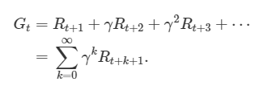
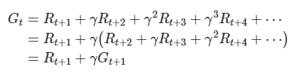

Discounted Return
To define the discounted return, we first define the discount rate, γ, to be a number between 0 and 1. The discount rate will be the rate for which we discount future rewards and will determine the present value of future rewards. With this, we define the discounted return as
If the reward at each time step is a constant 1 and γ<1, then the return is
(Infinite Geometric Series)
Notes:
This infinite sum yields a finite result. If you want to understand this concept more deeply, then research infinite series convergence. For our purposes though, you’re free to just trust the fact that this is true, and understand the infinite sum of discounted returns is finite if the conditions we outlined are met.
<number>

Slide 14
How Good Is A State Or Action?
First, we'd probably like to know how likely it is for an agent to take any given action from any given state. In other words, what is the probability that an agent will select a specific action from a specific state? This is where the notion of policies comes into play, and we'll expand on this in just a moment.
Secondly, in addition to understanding the probability of selecting an action, we'd probably also like to know how good a given action or a given state is for the agent. In terms of rewards, selecting one action over another in a given state may increase or decrease the agent's rewards, so knowing this in advance will probably help our agent out with deciding which actions to take in which states. This is where value functions become useful, and we'll also expand on this idea in just a bit.
Notes:
<number>

Slide 15
Policies
A policy is a function that maps a given state to probabilities of selecting each possible action from that state. We will use the symbol π to denote a policy.
When speaking about policies, formally we say that an agent “follows a policy.” For example, if an agent follows policy π at time t, then π(a|s) is the probability that A_{t}=a if S_{t}=s. This means that, at time t, under policy π, the probability of taking action a in state s is π(a|s).
Note that, for each state s∈S, π is a probability distribution over a∈A(s).

Slide 16
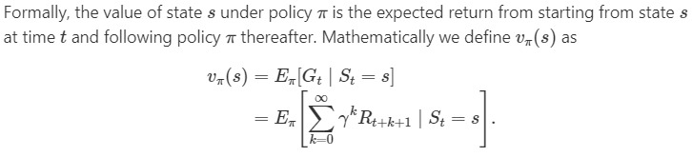
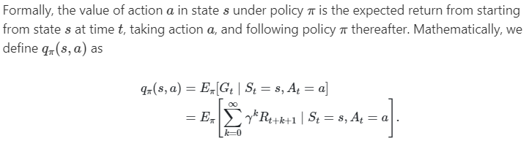
Value Functions following Policy
State-Value Function
Action-Value Function
Notes:
The state-value function for policy π, denoted as vπ, tells us how good any given state is for an agent following policy π. In other words, it gives us the value of a state under π.
Similarly, the action-value function for policy π, denoted as qπ, tells us how good it is for the agent to take any given action from a given state while following policy π. In other words, it gives us the value of an action under π.
<number>

Slide 17
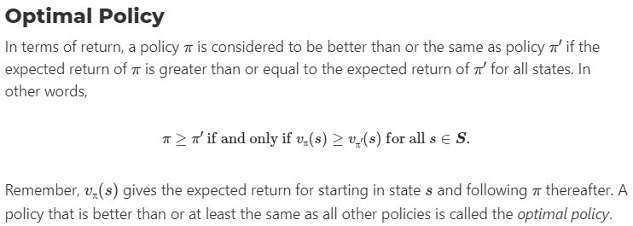
What Do Reinforcement Learning Algorithms Learn?
It is the goal of reinforcement learning algorithms to find a policy that will yield a lot of rewards for the agent if the agent indeed follows that policy. Specifically, reinforcement learning algorithms seek to find a policy that will yield more return to the agent than all other policies.

Slide 18
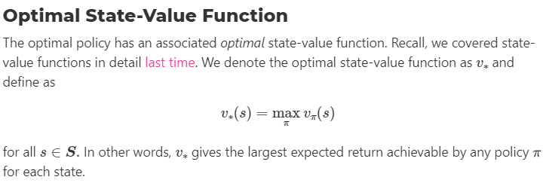
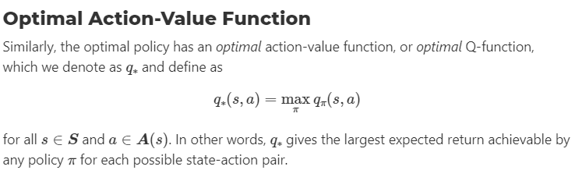
Optimal Functions

Slide 19
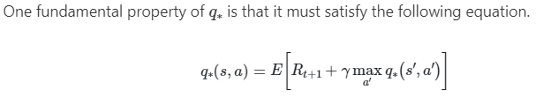
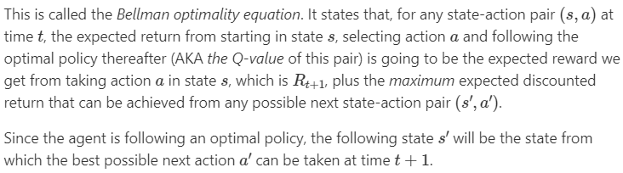
Q-Function (Bellman Optimality Equation for Q*)
Notes:
<number>
We're going to see how we can use the Bellman equation to find q∗. Once we have q∗, we can determine the optimal policy because, with q∗, for any state s, a reinforcement learning algorithm can find the action a that maximizes q∗(s,a).
We’re going to use this Bellman equation a lot going forward, so it will continue to materialize for us more as we progress.

Slide 20
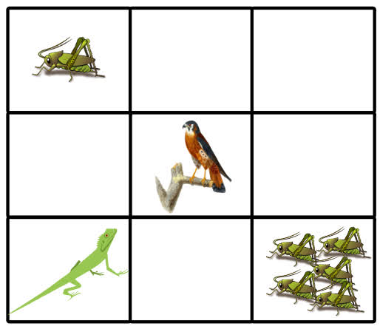
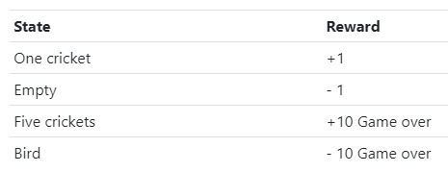
Q-Learning example
Finite MDP and reward
Now, at the start of the game, the lizard has no idea how good any given action is from any given state. It’s not aware of anything besides the current state of the environment.
Therefore, the Q-values for each state-action pair will all be initialized to zero since the lizard knows nothing about the environment at the start. As the game is played, though, the Q-values will be iteratively updated using the Q-learning update rule (see Update the Q-Table).
A:
right
down
up
left
Notes:
In other words, at the beginning, the lizard doesn’t know whether navigating left, right, up, or down will result in a positive reward or negative reward.
<number>

Slide 21
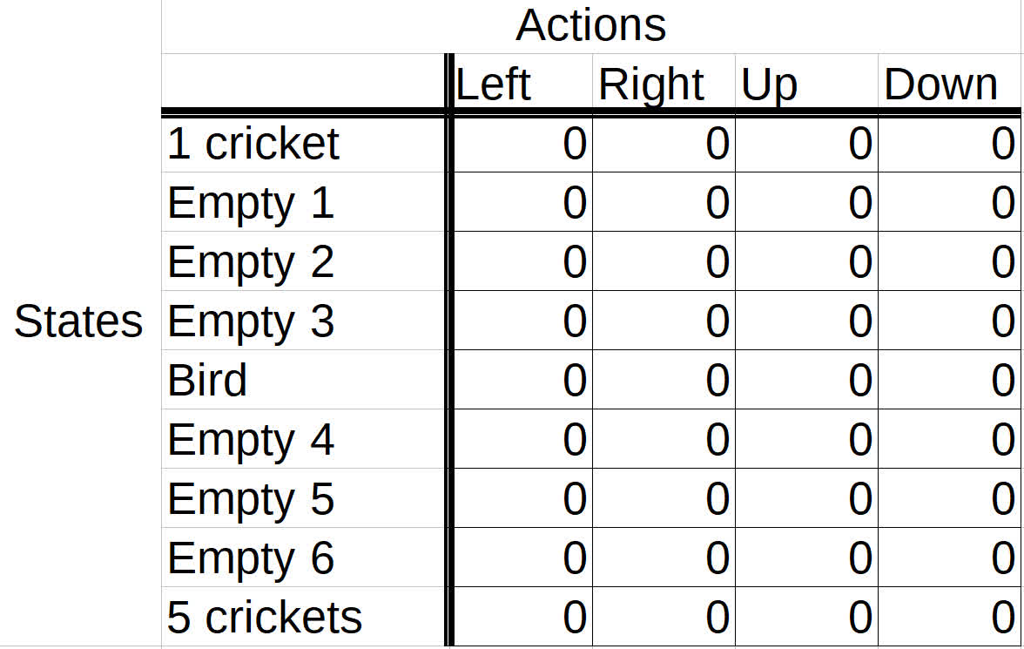
Storing Q-Values In A Q-Table
At the start
Episodes
Let’s say we want the lizard to play five episodes. It is during these episodes that the learning process will take place.
In each episode, the lizard starts out by choosing an action from the starting state based on the current Q-values in the table. The lizard chooses the action based on which action has the highest Q-value in the Q-table for the current state.
But, wait... That’s kind of weird for the first actions in the first episode, right?

Slide 22
Exploration Vs. Exploitation
Exploration is the act of exploring the environment to find out information about it.
Exploitation is the act of exploiting the information that is already known about the environment in order to maximize the return.
Think of our game. If our lizard got to the single cricket before it got to the group of five crickets, then only making use of exploitation, going forward the lizard would just learn to exploit the information it knows about the location of the single cricket to get single incremental points infinitely. It would then also be losing single points infinitely just to back out of the tile before it can come back in to get the cricket again.

Slide 23
Exploration Vs. Exploitation
(Cont.)
Epsilon Greedy Strategy
With this strategy, we define an exploration rate ϵ that we initially set to 1. This exploration rate is the probability that our agent will explore the environment rather than exploit it. With ϵ=1, it is 100% certain that the agent will start out by exploring the environment.
As the agent learns more about the environment, at the start of each new episode, ϵ will decay by some rate that we set so that the likelihood of exploration becomes less and less probable as the agent learns more and more about the environment. The agent will become “greedy” in terms of exploiting the environment once it has had the opportunity to explore and learn more about it.

Slide 24
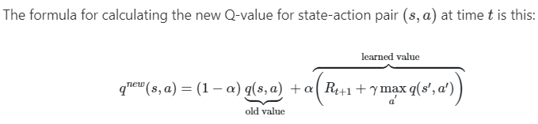
Update the Q-Table
To update the Q-value for the action of moving right taken from the previous state, we use the Bellman equation.
We want to make the Q-value for the given state-action pair as close as we can to the right hand side of the Bellman equation so that the Q-value will eventually converge to the optimal Q-value.
Learning rate

Slide 25
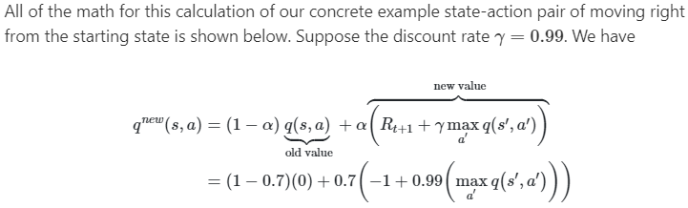

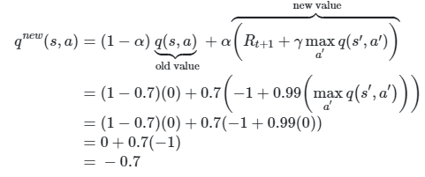
Update example
0
Learning rate α = 0.7
x
Notes:
<number>

Slide 26
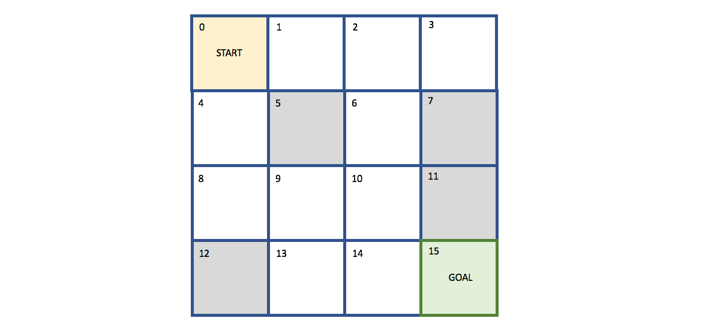
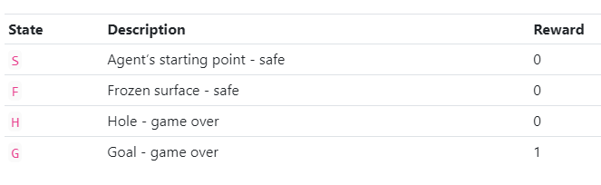
Code example
Gymnasium (the maintained successor of OpenAI Gym) has a ton of environments ranging from simple text-based games to Atari games like Breakout and Space Invaders.
Frozen Lake
Try it on the course website: Lectures → Semester 1 → Week 11 → 3 Tutorial → FrozenLake_RL_Exploration.ipynb (it runs in your browser).
Notes:
This grid is our environment where S is the agent’s starting point, and it’s safe. F represents the frozen surface and is also safe. H represents a hole, and if our agent steps in a hole in the middle of a frozen lake, well, that’s not good. Finally, G represents the goal, which is the space on the grid where the prized frisbee is located.
<number>

Slide 27
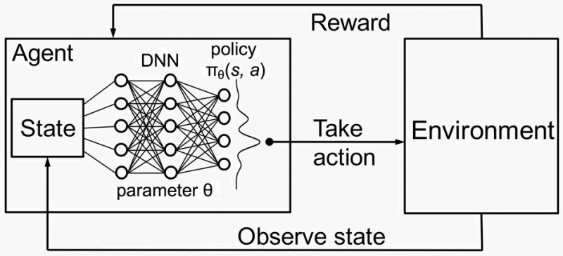
Combining Reinforcement learning with Deep Learning

Slide 28
Conclusion
Reinforcement learning addresses a very broad and relevant question: How can we learn to survive in our environment?
We have looked at Q-learning, which simply learns from experience. No model of the world is needed.
We made simplifying assumptions: e.g. state of the world only depends on last state and action. This is the Markov assumption. The model is called a Markov Decision Process (MDP).
We assumed deterministic dynamics, reward function, but the world really is stochastic.
There are many extensions to speed up learning.
There have been many successful real world applications.
Further reading: Sutton & Barto, Reinforcement Learning: An Introduction (2nd ed., 2018)

